Slide 1
E-VOTE FINAL PRESENTATION
GROUP 1 – FRIMPONG FELIX NANA – F15040121

Slide 2
REALIZED FUNCTIONALITITES
SUPPOSED:-
1. One time login pass
2. Database query for pass
3. Correct Vote Count
4. Administrator access to vote count
Realized :-
Regular login pass with ID and Pass
Database query for pass
Correct vote count
Administrator access to vote count

Slide 3
Development
In the process of development I used the NetBean IDE and standard Java still in the process.
With the git version control system embeded in Netbeans I commited the project to the github repository for our group under the branch Feature1.
All code and issues are accounted for on the github page and if you follow the commit changes you’ll realize that I fixed bugs before moving to to any new phase in the project development phase.

Slide 4
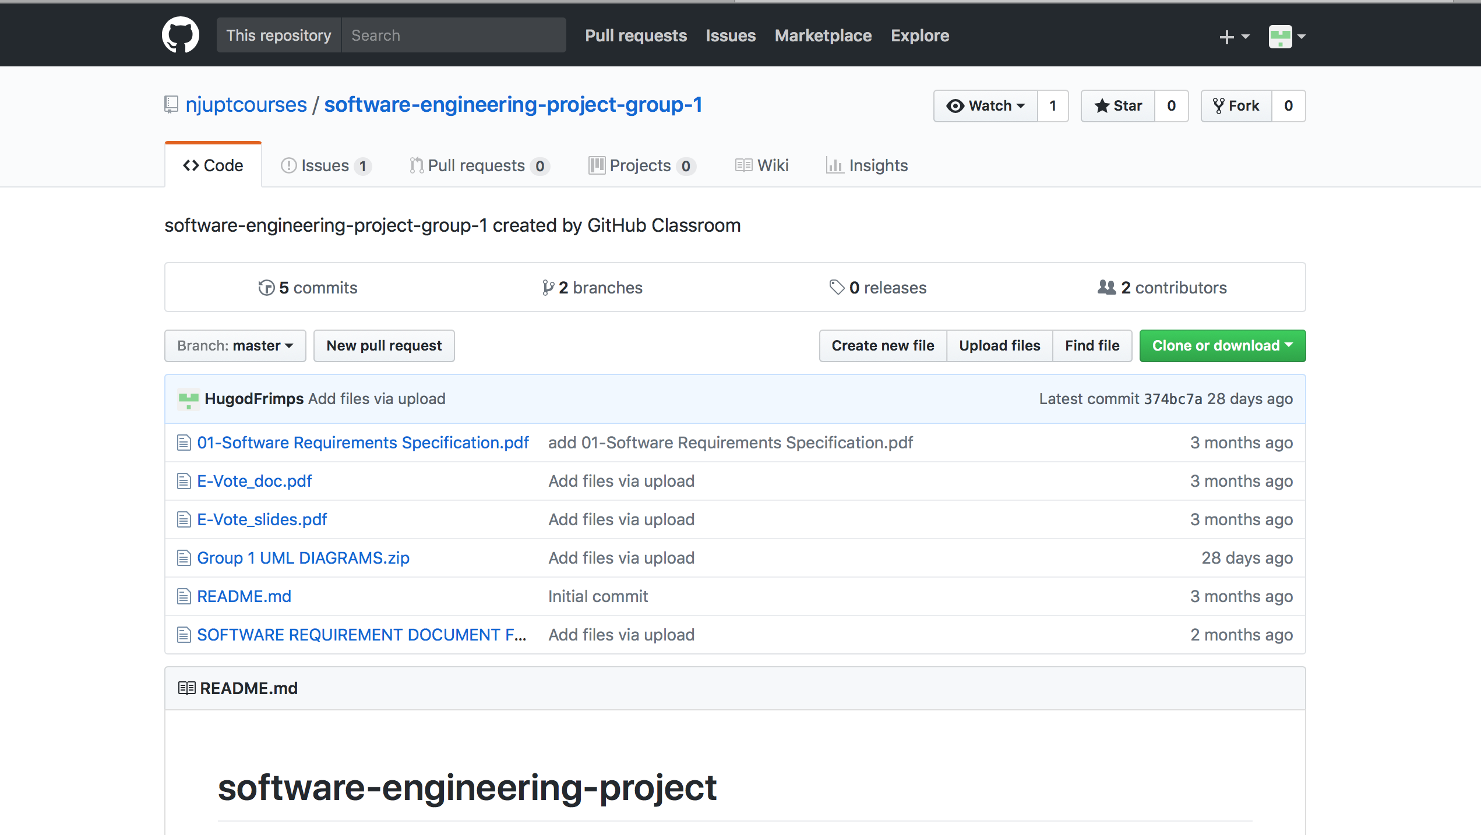
GIT PAGE IMAGEs

Slide 5
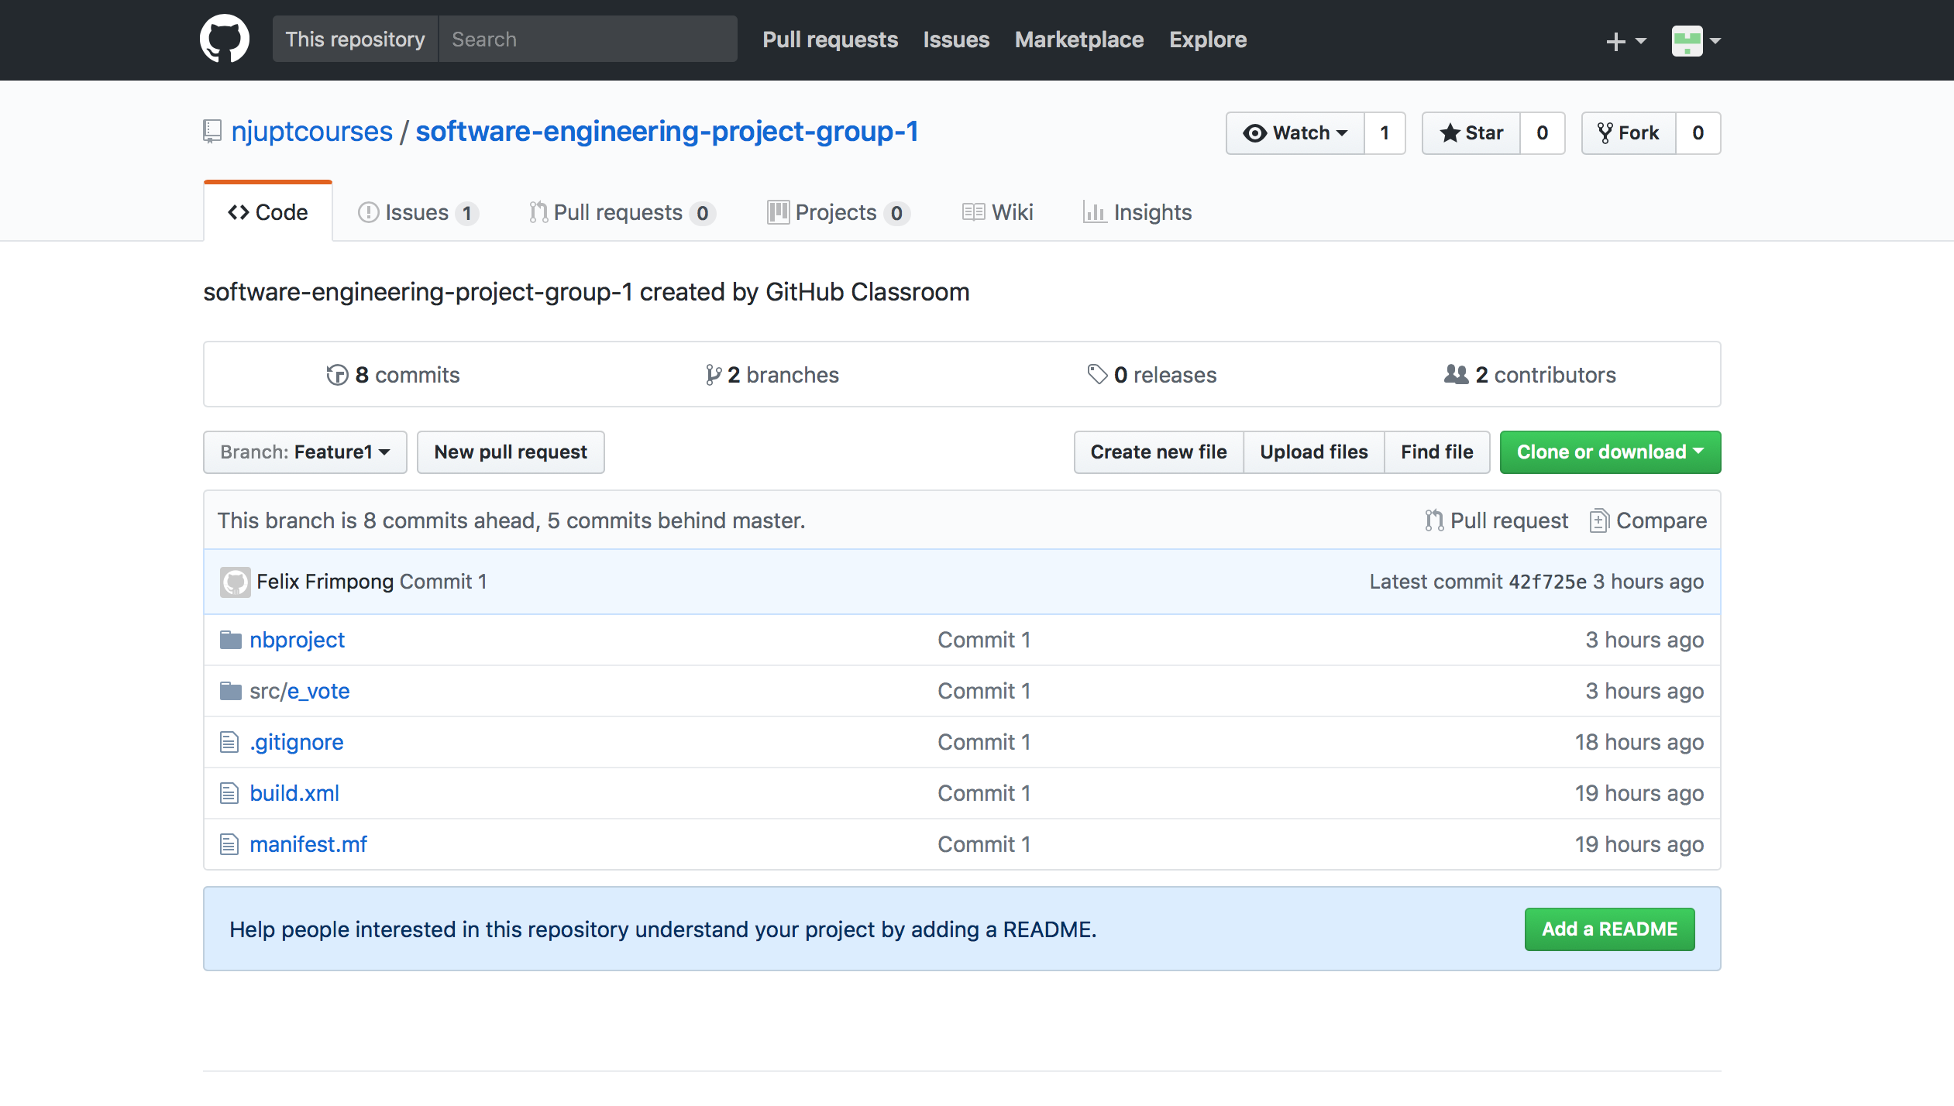
GIT page images

Slide 6
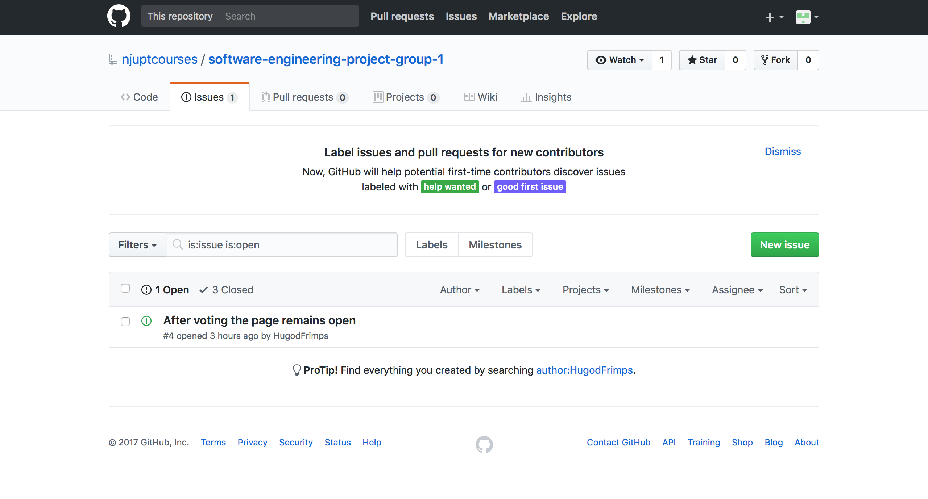
Git page images

Slide 7
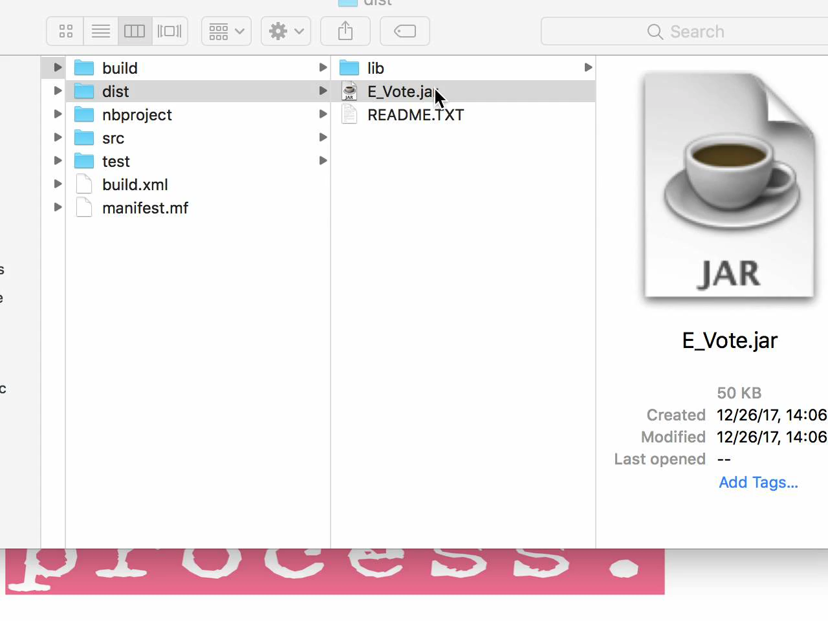
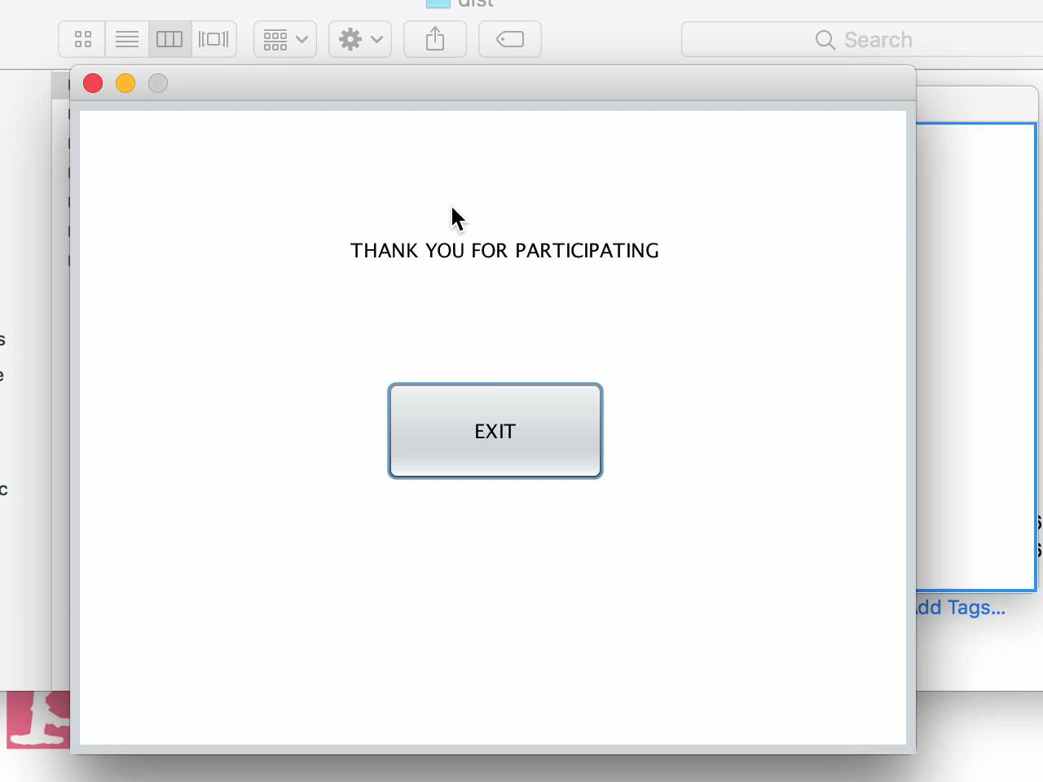
App demonstration

Slide 8
E-VOTE FINAL PRESENTATION- Thank you
GROUP 1 – FRIMPONG FELIX NANA – F15040121

